Slide 1
ICCUBE BOOTCAMP #1

Slide 2
GOALS

Slide 3
BOOTCAMP TAKE AWAYS
IMPORT DATA FROM A CSV FILE, ON FAVORITE BURGER PLACES
CREATE A CUBE
ACCESS DATA FROM EXCEL
CREATE REPORTS

Slide 4
GOALS
What is IcCube
Install free version of IcCube locally
Start the iccube server
Walk around the different screens
Create your first Schema
Create your first report
2 more extra reports

Slide 5
ICCUBE in ONE SLIDE

Slide 6

ICCUBE
BI TOOLS
FREE VERSION
NO COMPILATION
JAVA BASED
REAL TIME AGGREGATION
OLAP BASED (MDX DRILL DOWN)
MIXED/ANY DATA SOURCE: JDBC, FILES, HTTP, MONGODB etc…
EXTRA: SCHEDULER
EXTRA: FAST ETL (EXTRACT TRANSFORM LOAD)

Slide 7
INSTALL ICCUBE

Slide 8
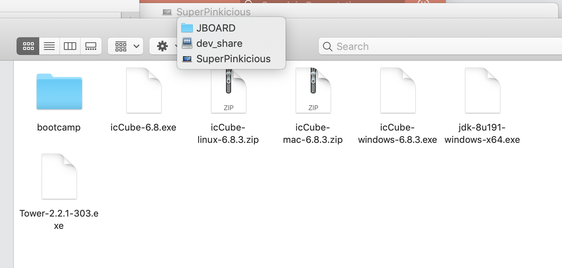
RETRIEVE / EXTRACT INSTALLER
http://gitlab.otc/bi/bootcamp
git clone git@gitlab.otc:bi/bootcamp.git
Unzip icCube-6.8.2.zip

Slide 9
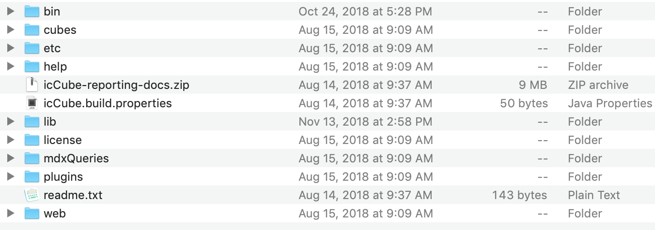
Start UP ICcube
In the extracted folder, look for the bin folder.
Run:
./icCube.sh or (icCube.bat on windows)

Slide 10
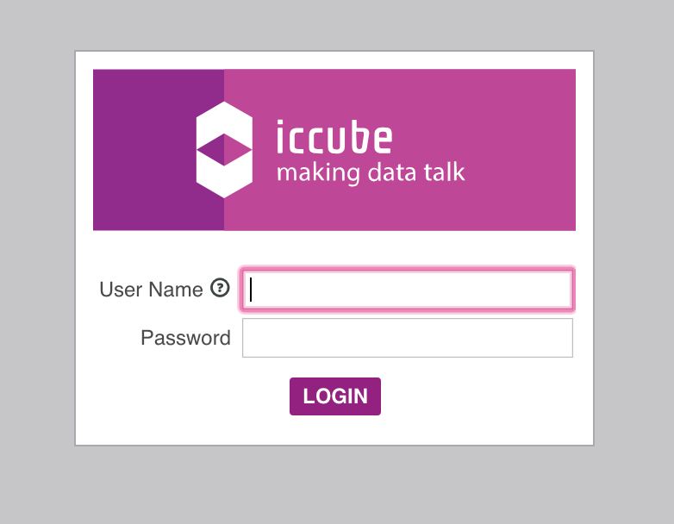
FIRST LOGIN
http://localhost:8282/icCube/icCube.html
admin
/
admin

Slide 11
SCREENS OVERVIEW

Slide 12
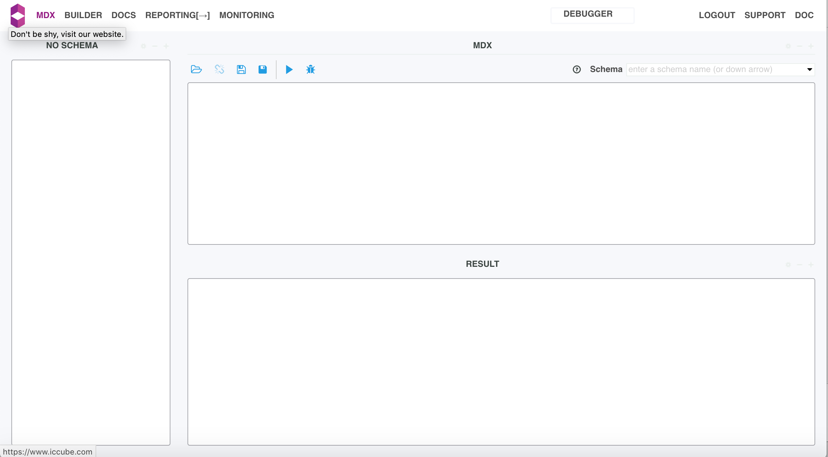
ADMIN SCREEN OVERVIEW
SERVER RUNTIME INFO
LINK TO REPORTING
MDX CONSOLE
REPORTING DEPLOYMENT
SCHEMA CREATION
ICCUBE ONLINE HELP

Slide 13
QUICK ARCHITECTURE OVERVIEW

Slide 14
QUICK STRUCTURE
icCube Server
icCube Reporting
Model Data
Use Data To Create Visual Reports

Slide 15
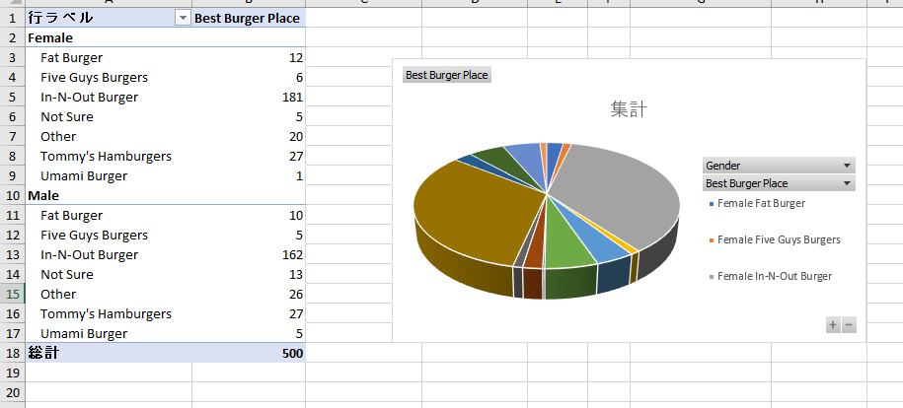
QUICK STRUCTURE
icCube Server
Model Data

Slide 16
BURGER DATA

Slide 17
BURGER.CSV
best_burger_place | gender
Five Guys Burgers | Male
Five Guys Burgers | Male
Five Guys Burgers | Male
Five Guys Burgers | Male
Five Guys Burgers | Male
Five Guys Burgers | Female
Five Guys Burgers | Female
Five Guys Burgers | Female
Five Guys Burgers | Female
Five Guys Burgers | Female
Five Guys Burgers | Female
In-N-Out Burger | Male
In-N-Out Burger | Male
In-N-Out Burger | Male
In-N-Out Burger | Male
In-N-Out Burger | Male
In-N-Out Burger | Male
In-N-Out Burger | Male
In-N-Out Burger | Male
In-N-Out Burger | Male
In-N-Out Burger | Male
In-N-Out Burger | Male
In-N-Out Burger | Male
In-N-Out Burger | Male
In-N-Out Burger | Male
In-N-Out Burger | Male

Slide 18
QUICK SCHEMA

Slide 19
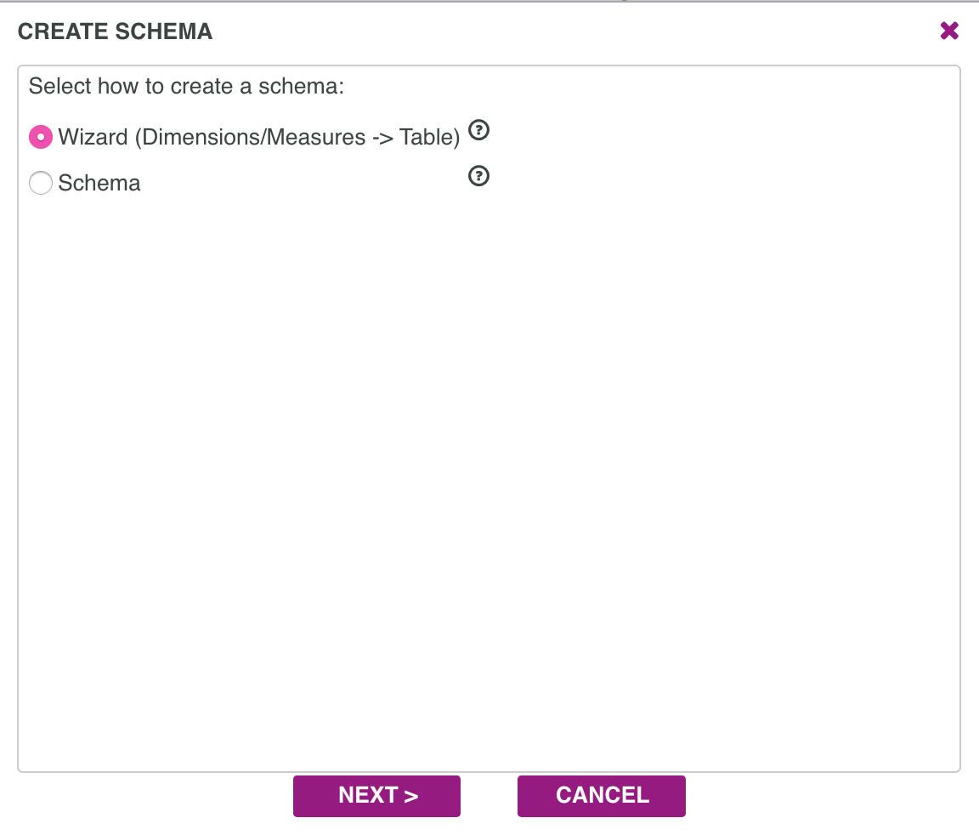
SCHEMA #1

Slide 20
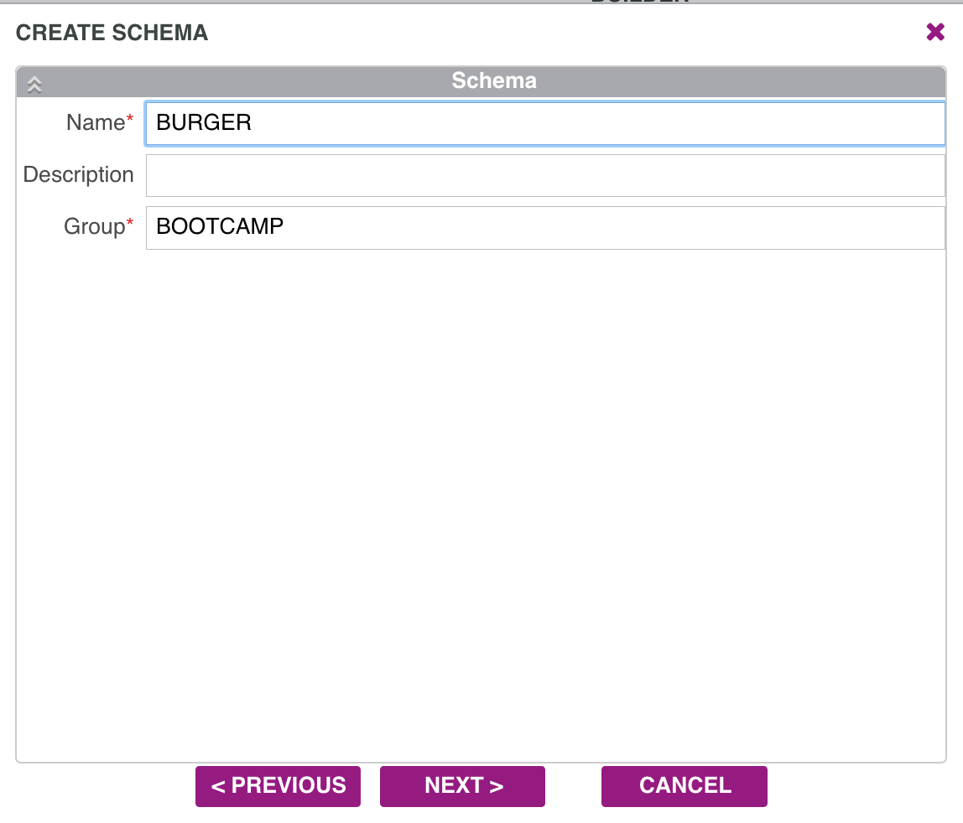
SCHEMA #2

Slide 21
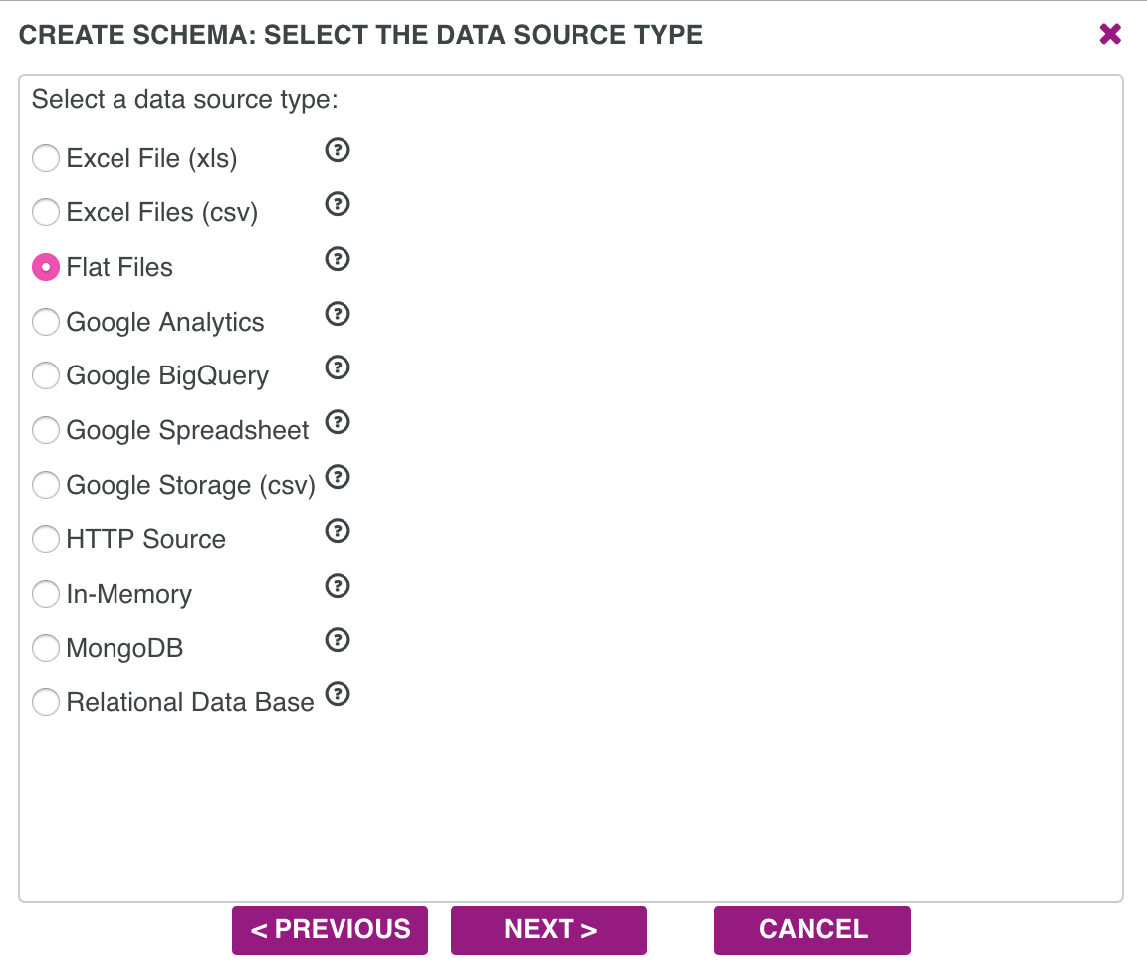
SCHEMA #3

Slide 22
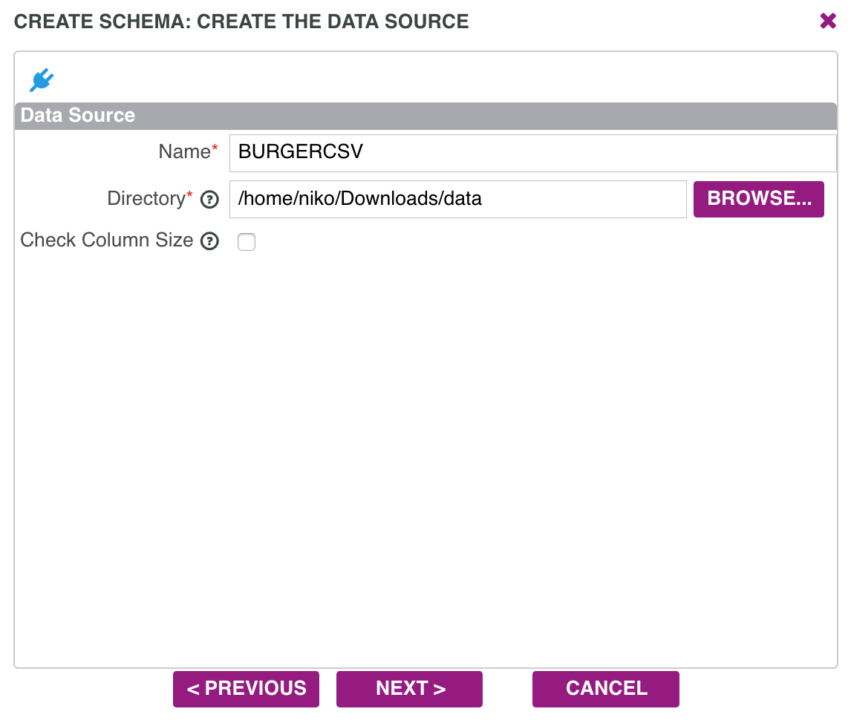
SCHEMA #4

Slide 23
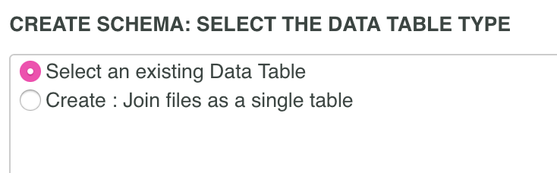
SCHEMA #5

Slide 24
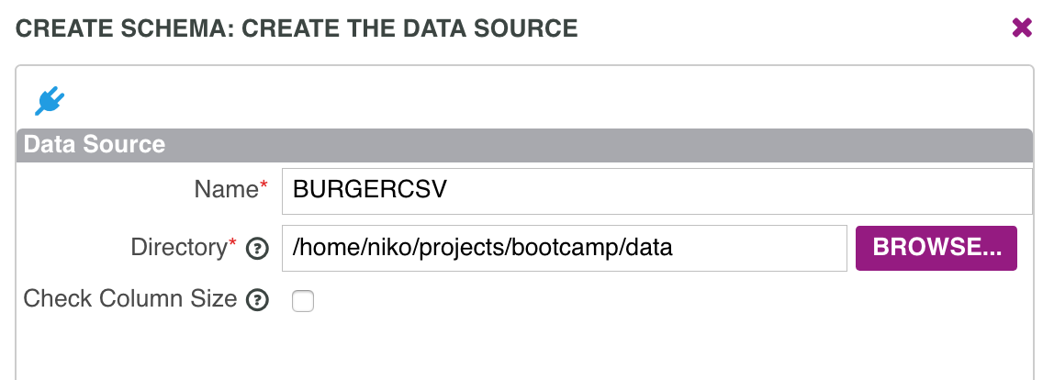
SCHEMA #6

Slide 25
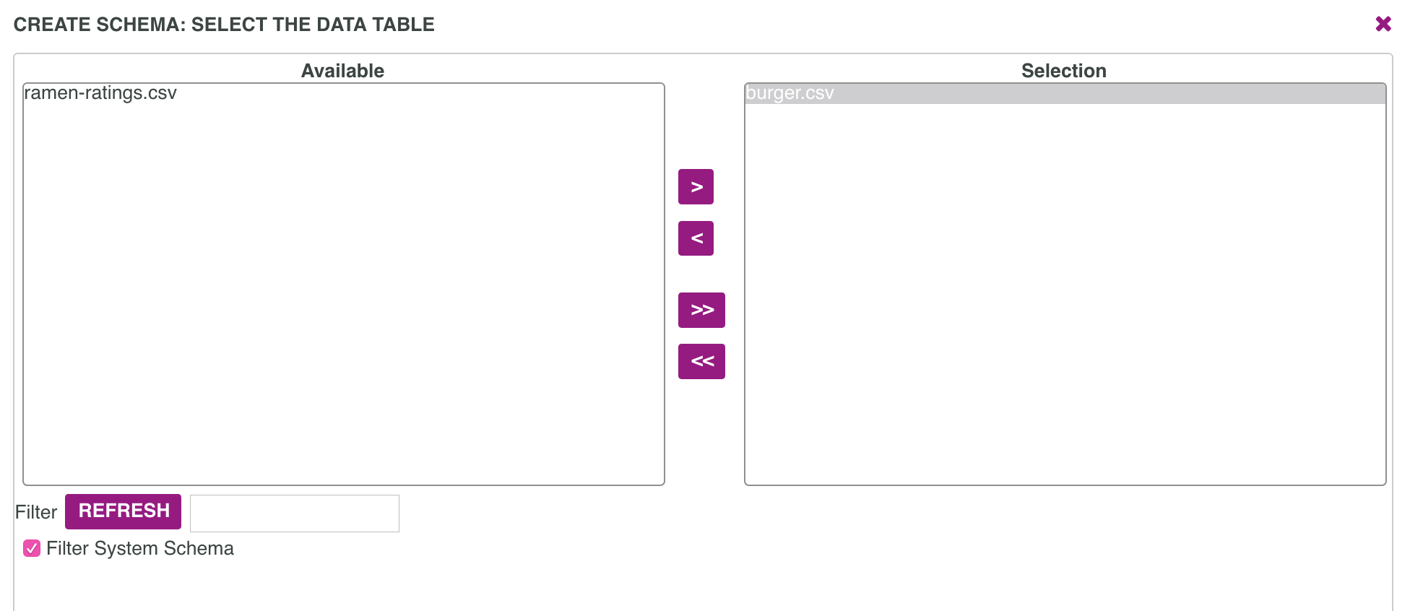
SCHEMA #7

Slide 26
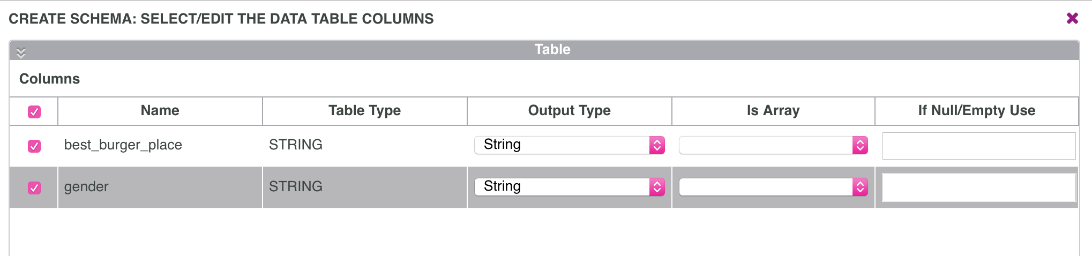
SCHEMA #8

Slide 27
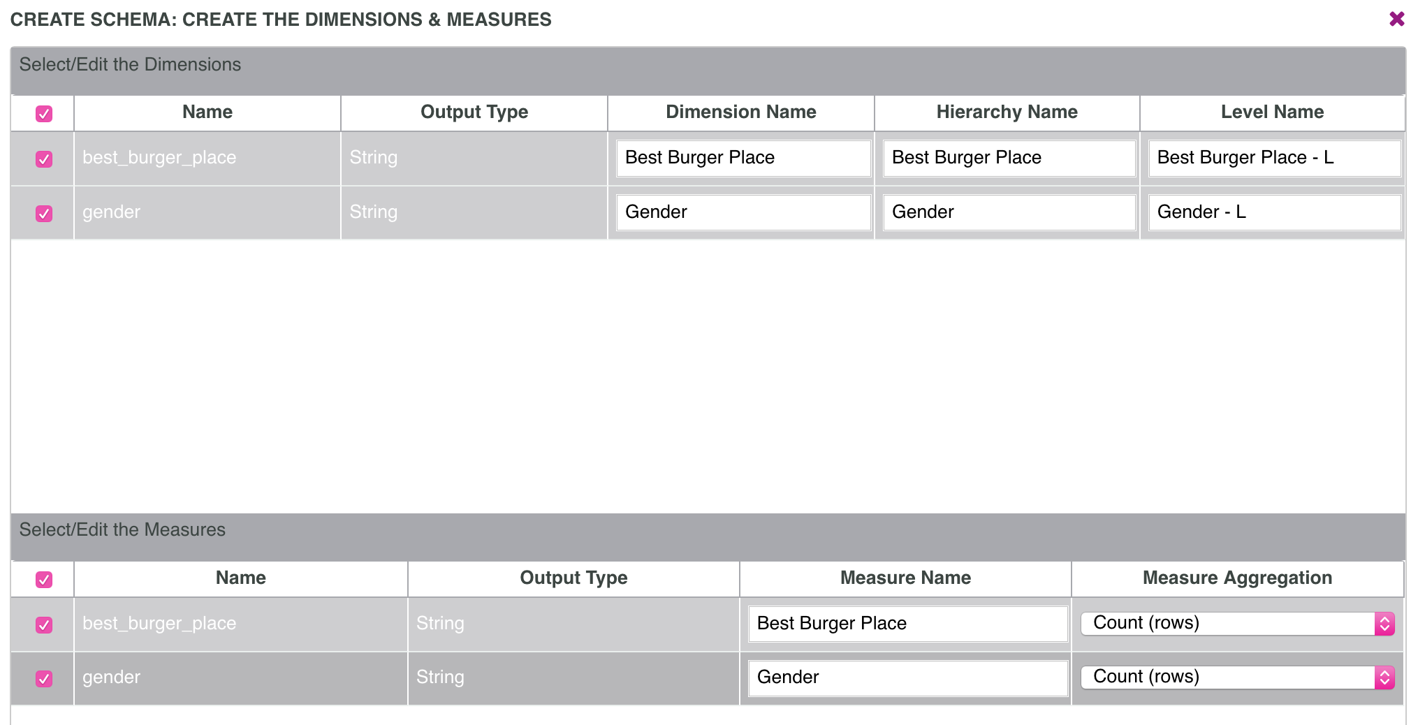
SCHEMA #9

Slide 28
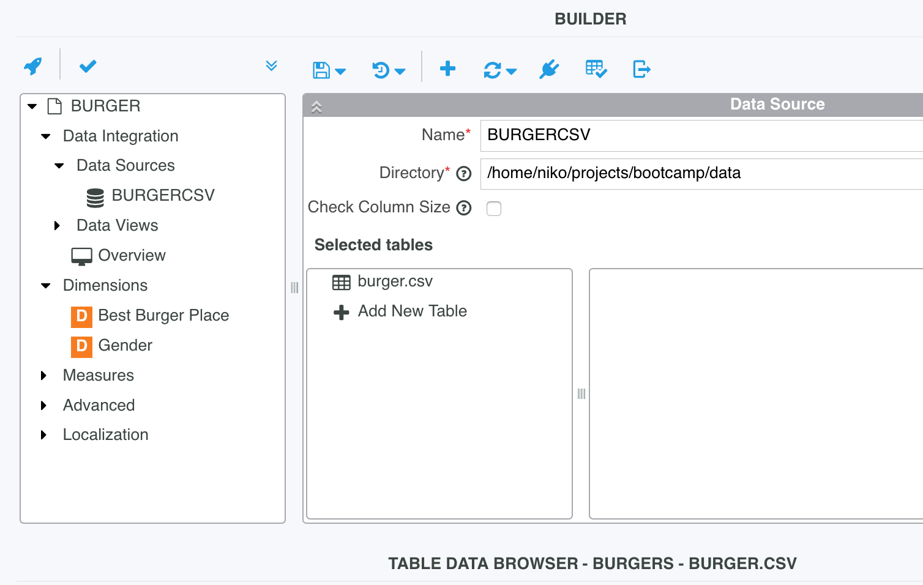
SCHEMA #10

Slide 29
OLAP, DIMENSIONS, HIERARCHY, CUBE, MEASURES

Slide 30
VOCABULARY
OLAP
Multidimensional array of data, stored in a star schema
The star schema consists of one or more fact tables referencing any number of dimension tables.
DIMENSIONS
Dimensions are derived from the dimension tables.
HIERARCHY
A dimension can have multiple hierarchy
Dimensions can be organized in parent-child hierarchies
MEASURES
Measures are derived from the records in the fact table
FACTS
CUBE
Multidimensional dataset

Slide 31
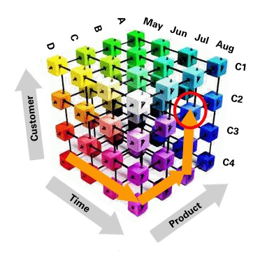
VOCABULARY

Slide 32
DEPLOY SCHEMA

Slide 33
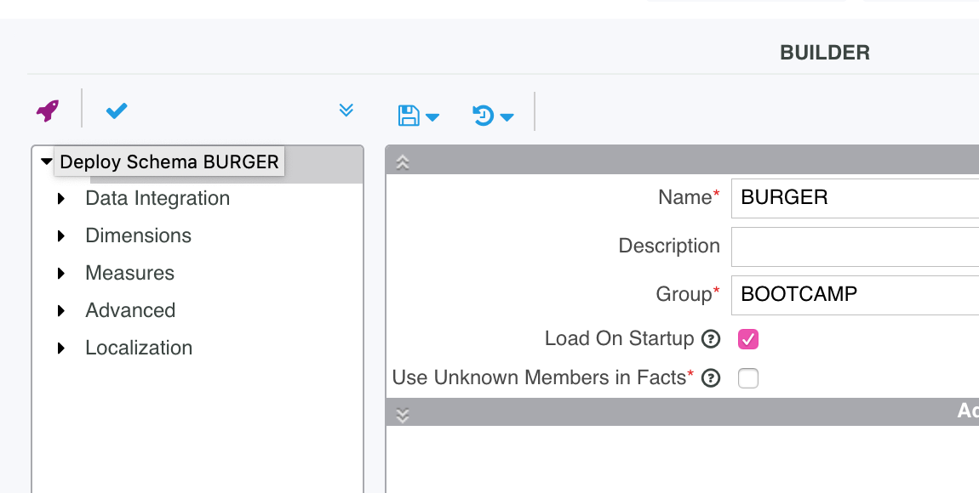
DEPLOY #1

Slide 34
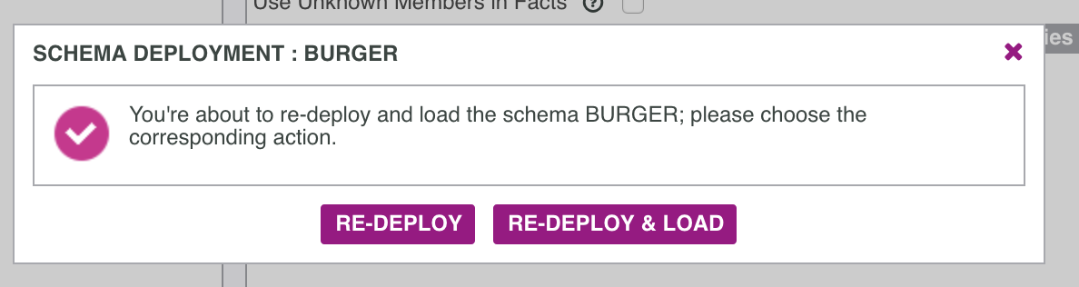
DEPLOY #2

Slide 35
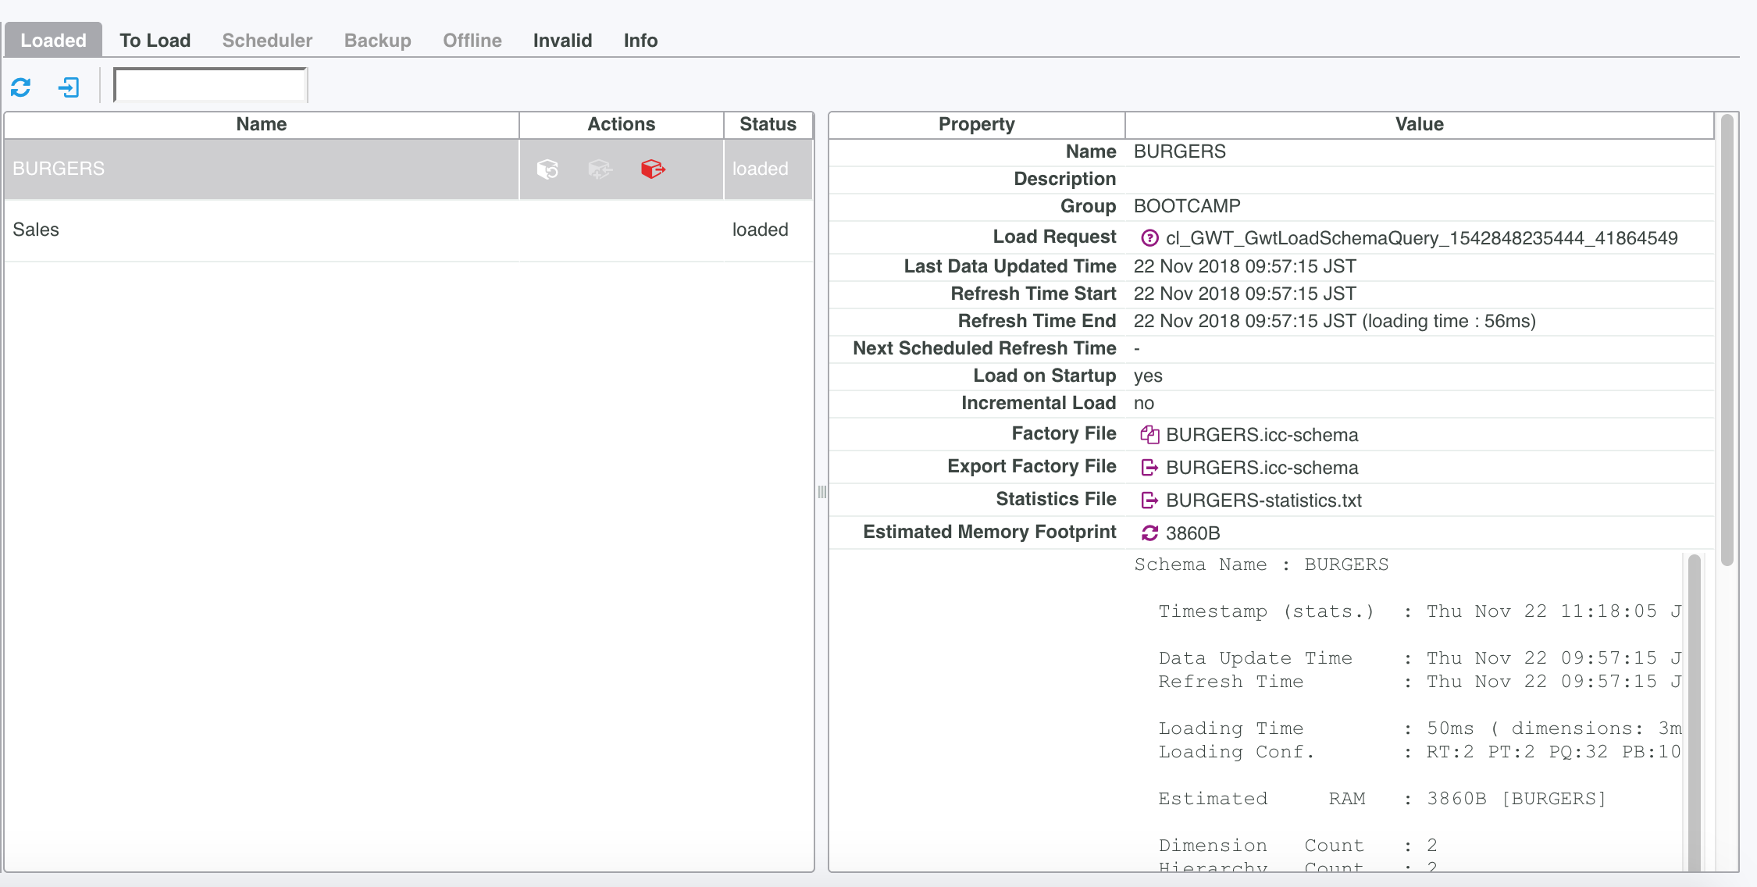
DEPLOY #3

Slide 36
VIEW DATA WITH EXCEL

Slide 37
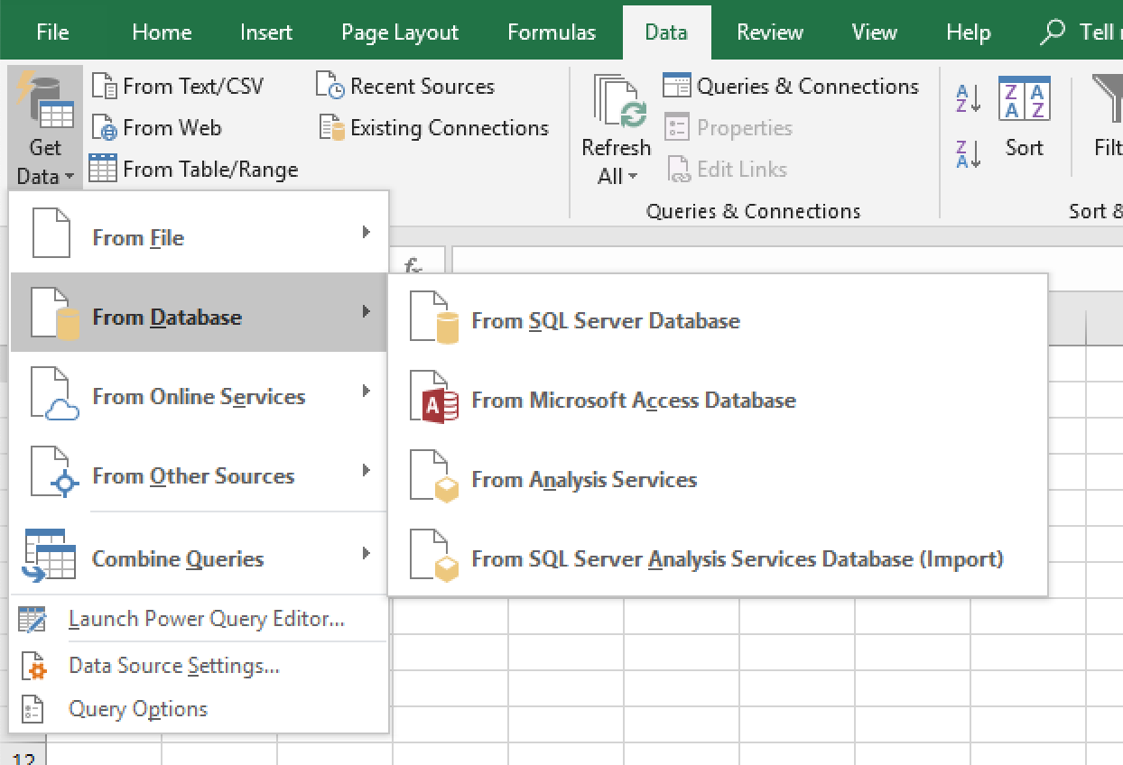
Excel #0

Slide 38
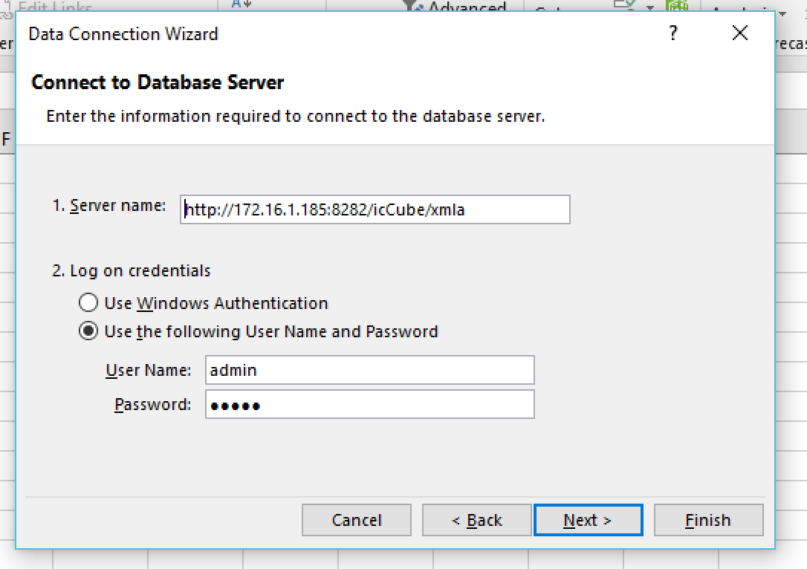
Excel #1

Slide 39
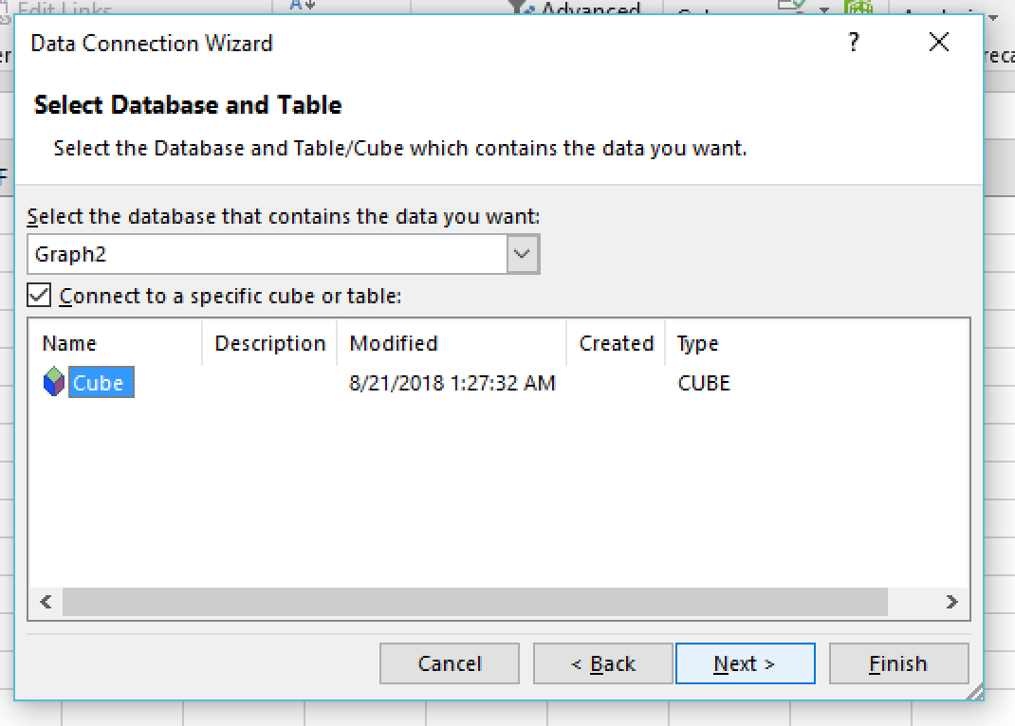
Excel #2

Slide 40
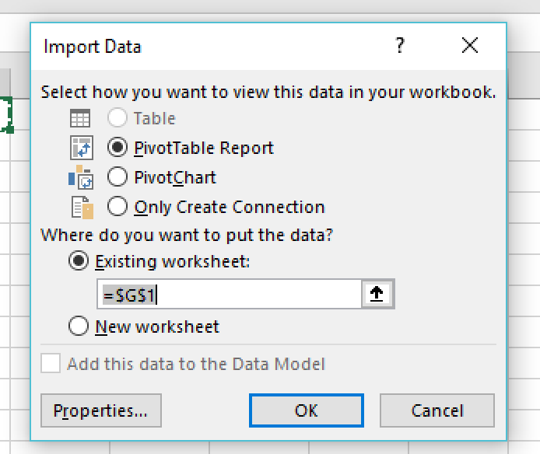
EXCEL #3

Slide 41
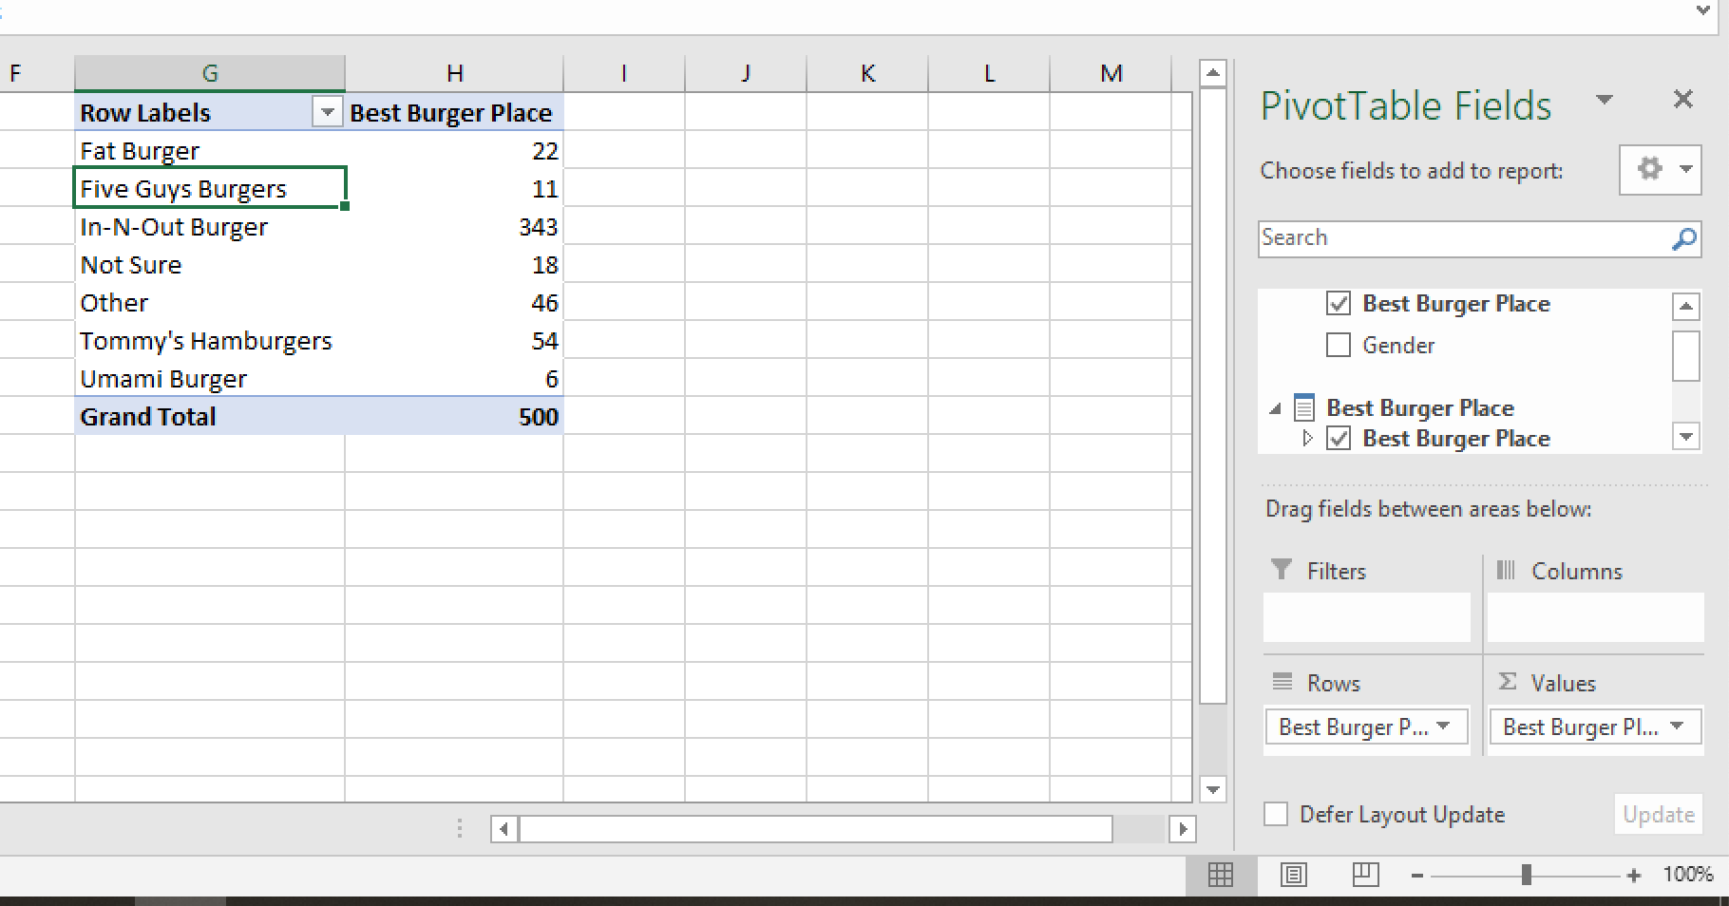
EXCEL #4

Slide 42
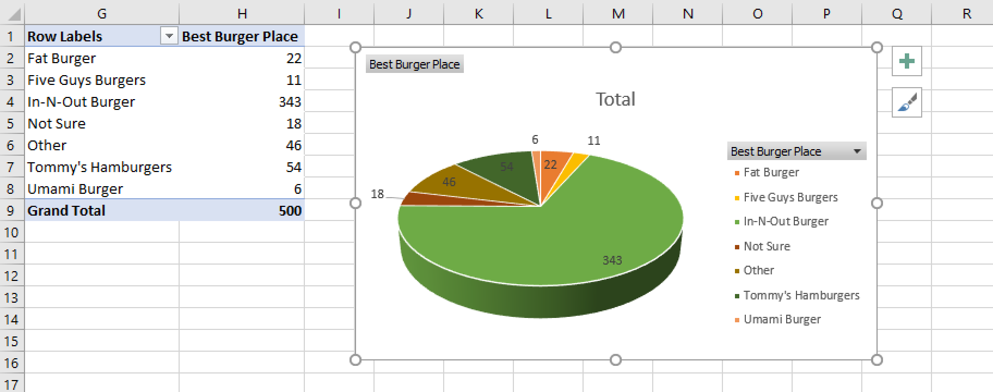
EXCEL #5

Slide 43
ICCUBE REPORTING

Slide 44
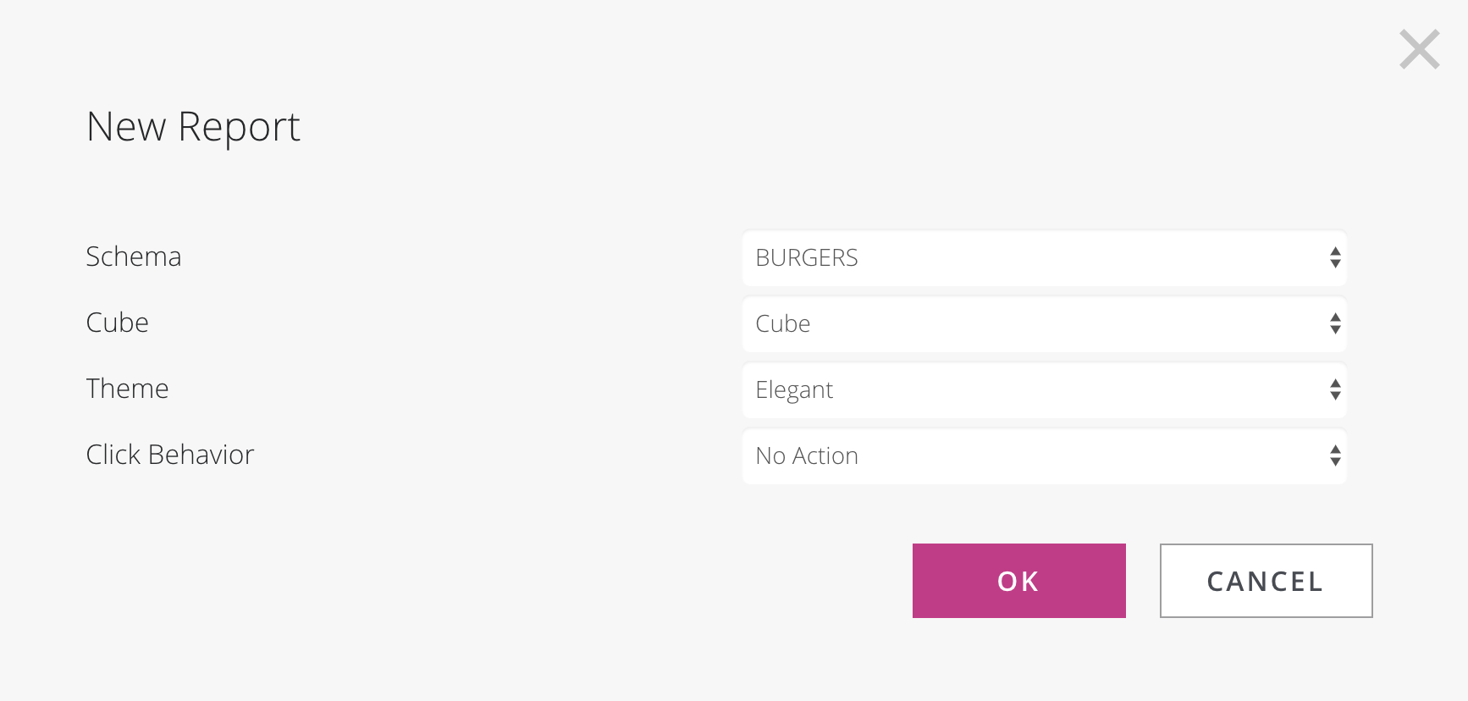
REPORT #1

Slide 45
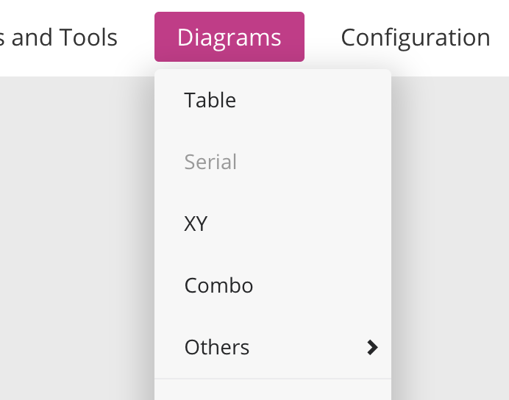
REPORT #2

Slide 46
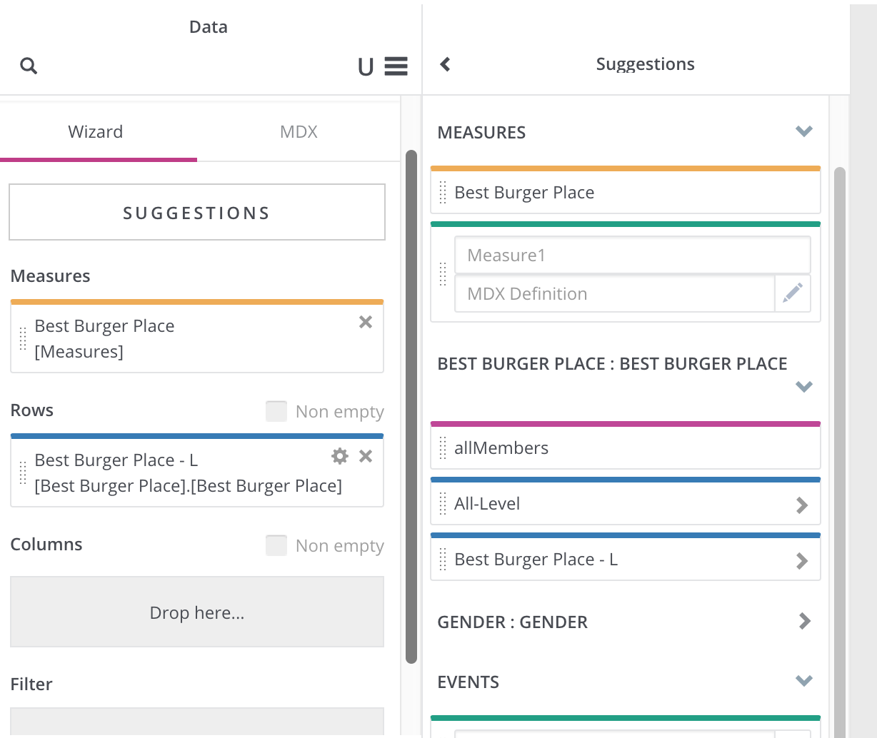
REPORT #3

Slide 47
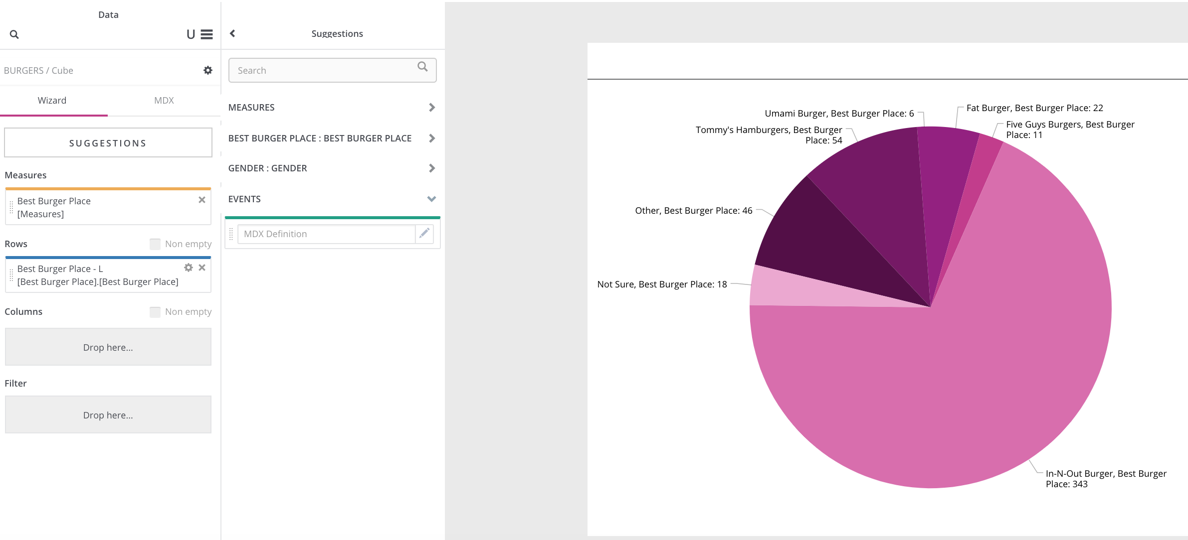
REPORT #4

Slide 48
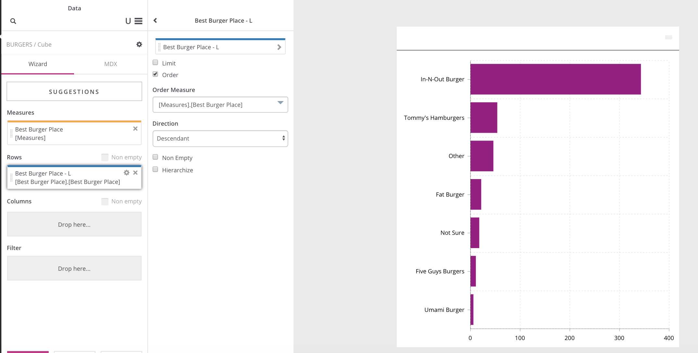
REPORT #5

Slide 49
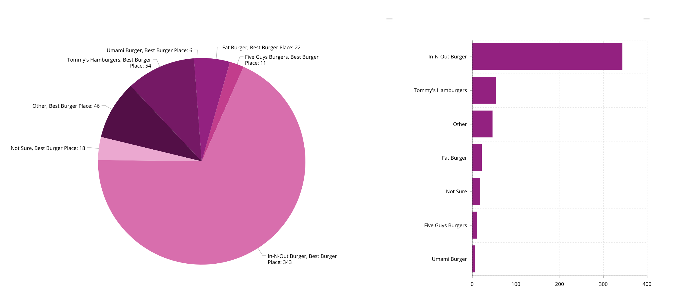
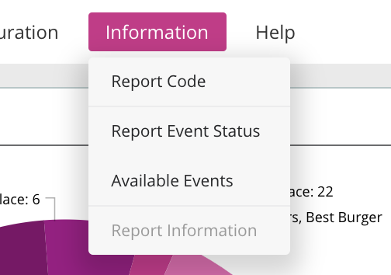
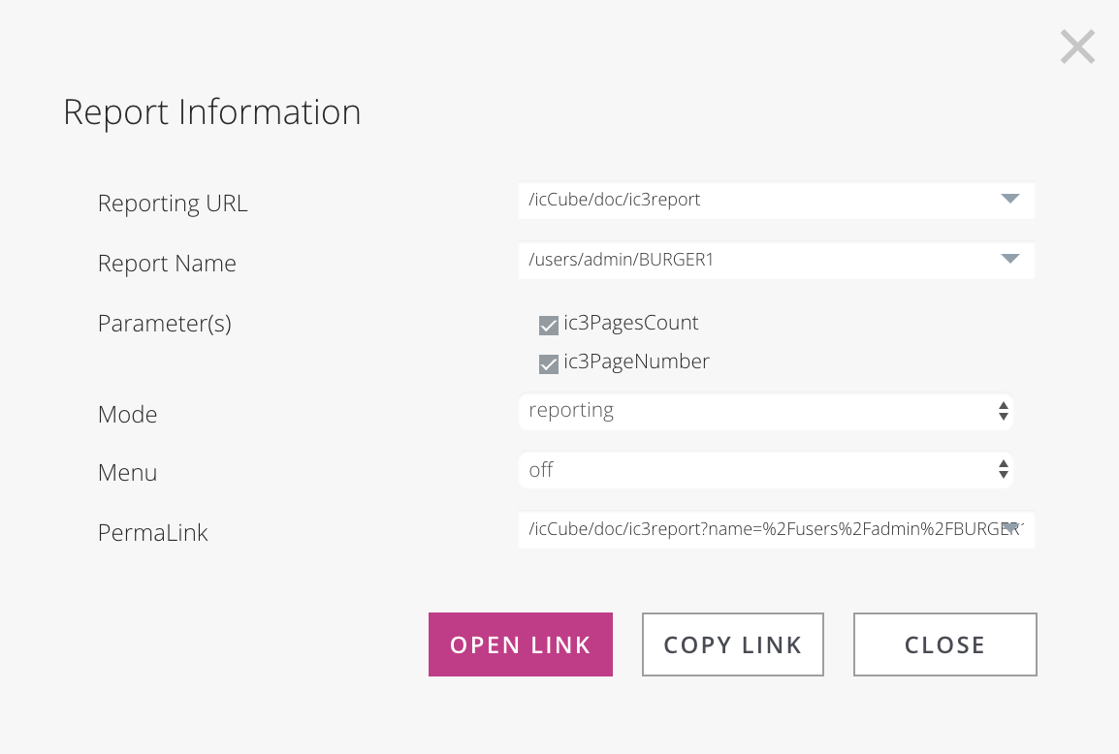
REPORT #6

Slide 50
ICCUBE REPORTING EXTRAS
SETTING UP A FILTER

Slide 51
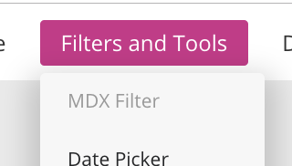
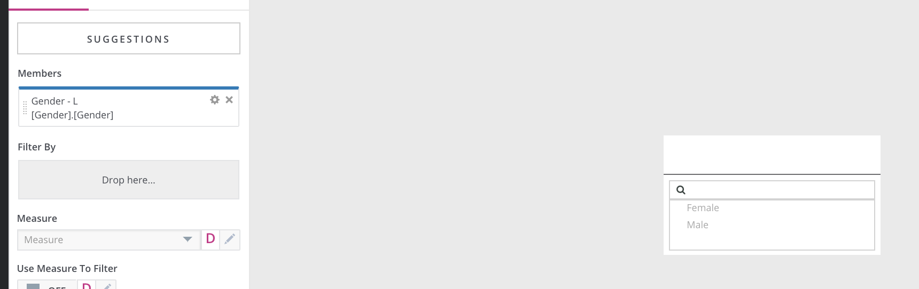
SETTING UP A FILTER #1

Slide 52
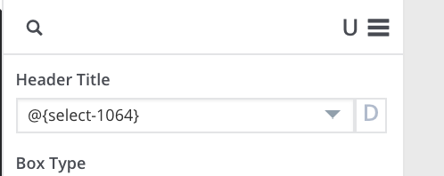
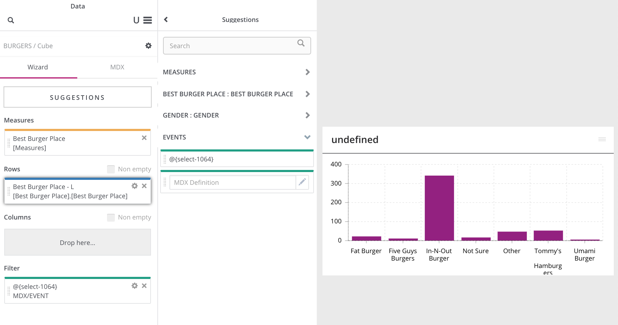
SETTING UP A FILTER #2

Slide 53
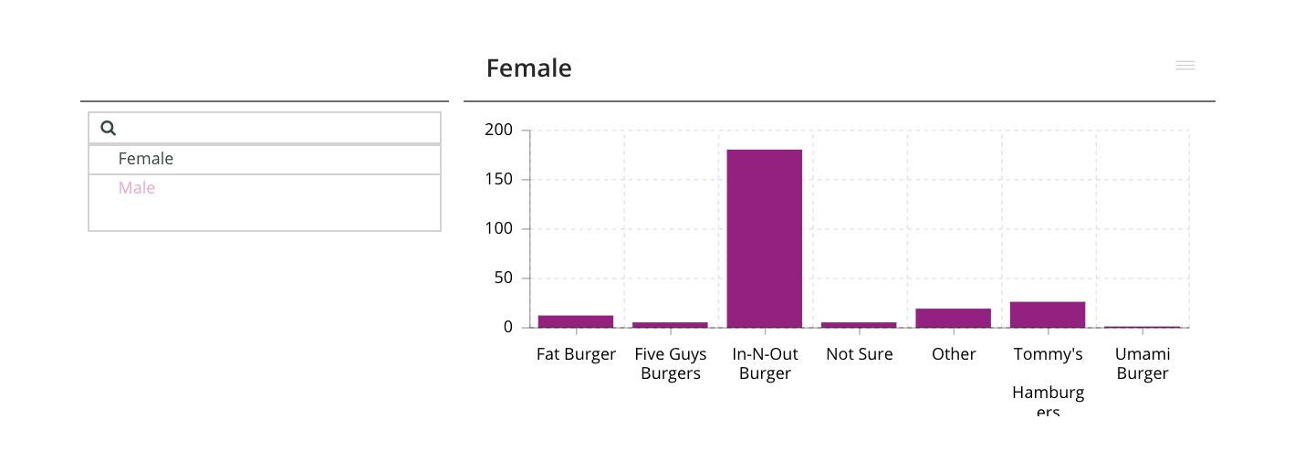
SETTING UP A FILTER #3

Slide 54
ICCUBE REPORTING EXTRAS
COLORS AND COLUMNS

Slide 55
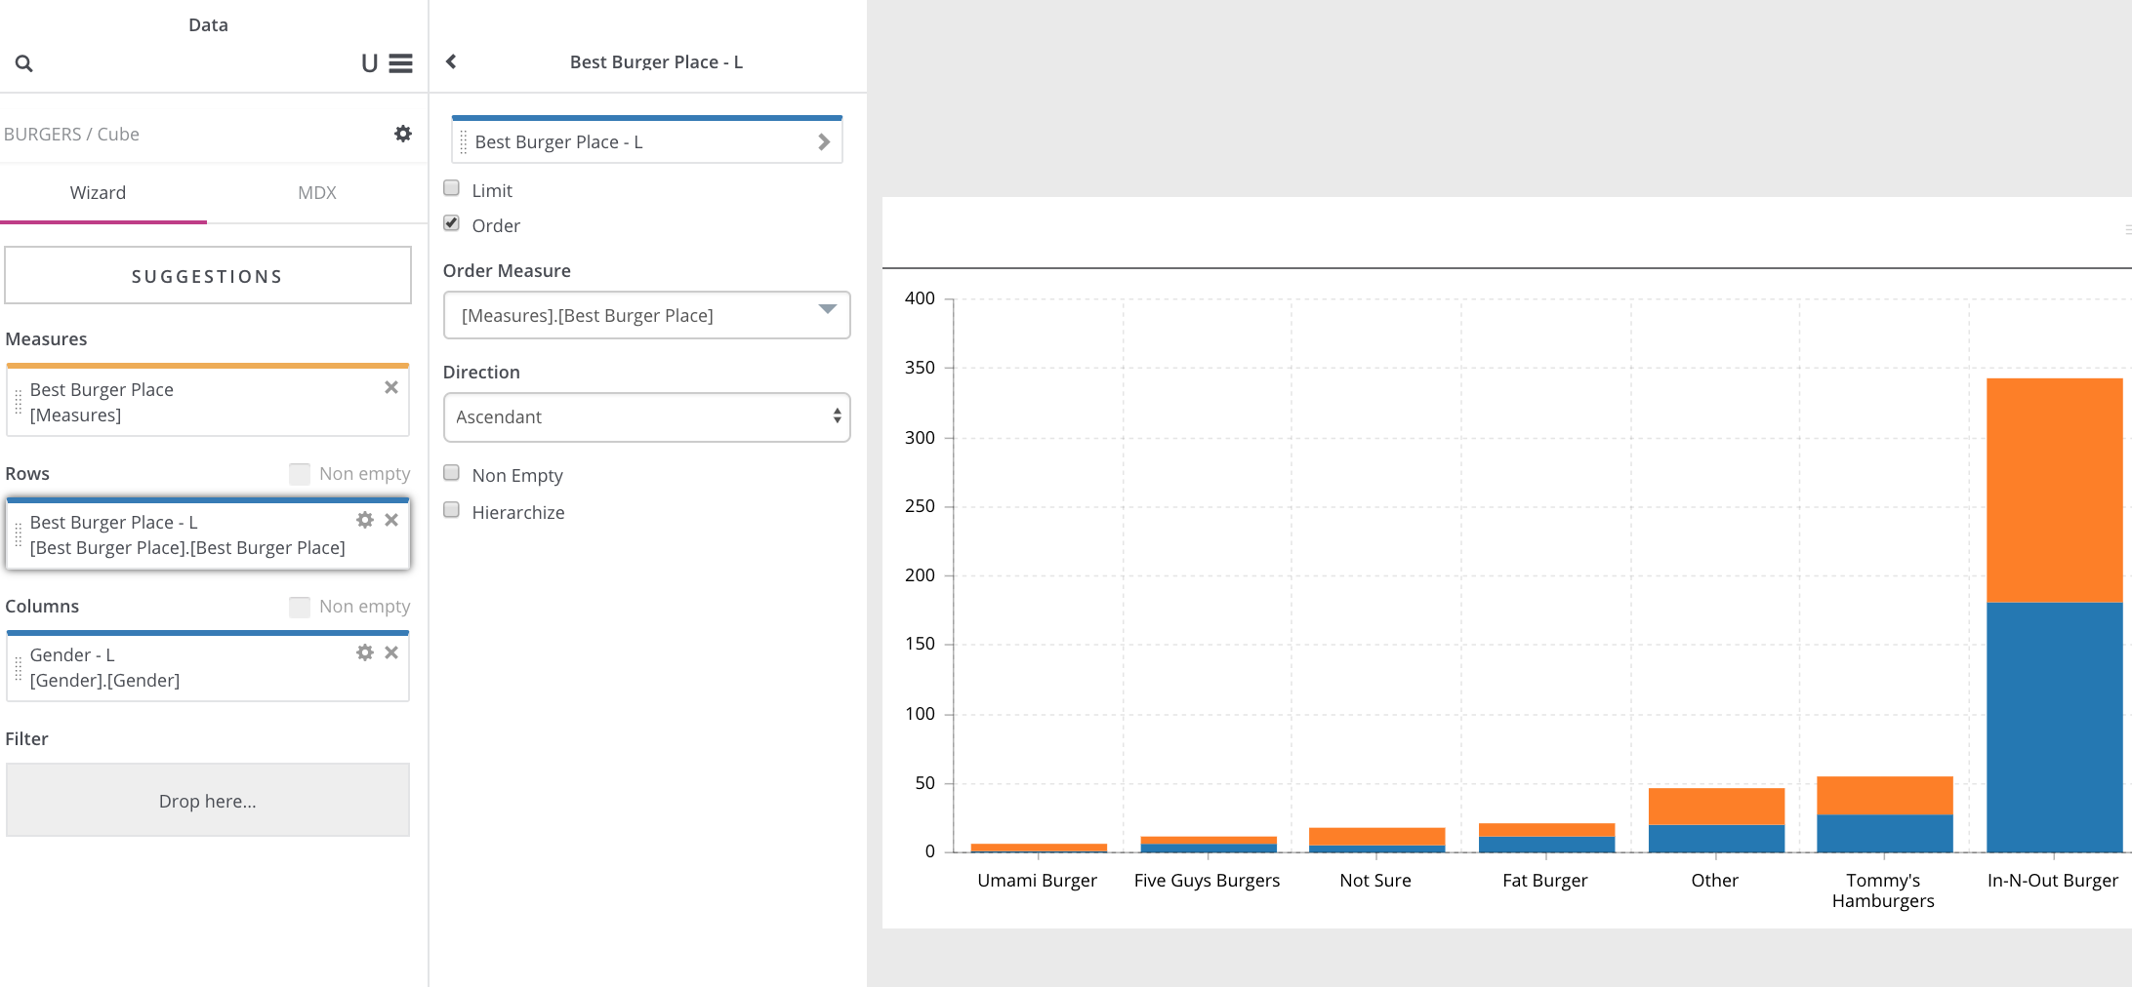
COLORS AND COLUMNS #1

Slide 56
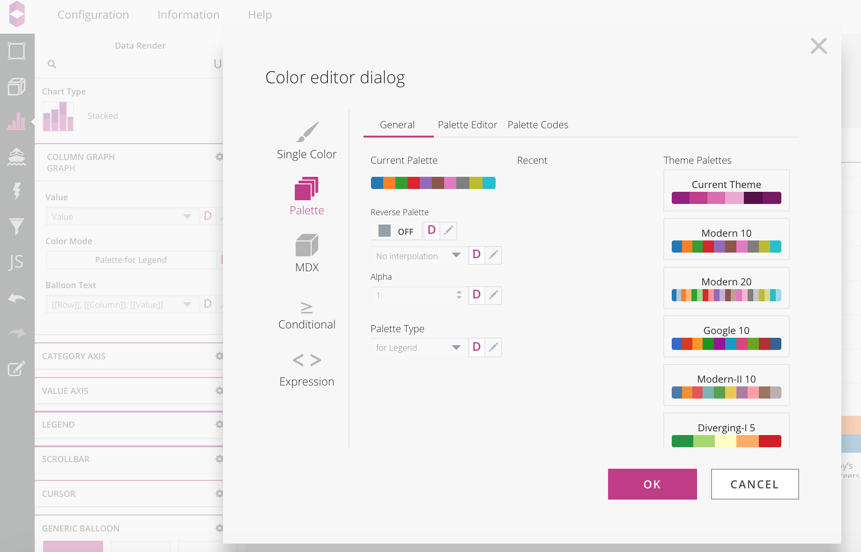
COLORS AND COLUMNS #2

Slide 57
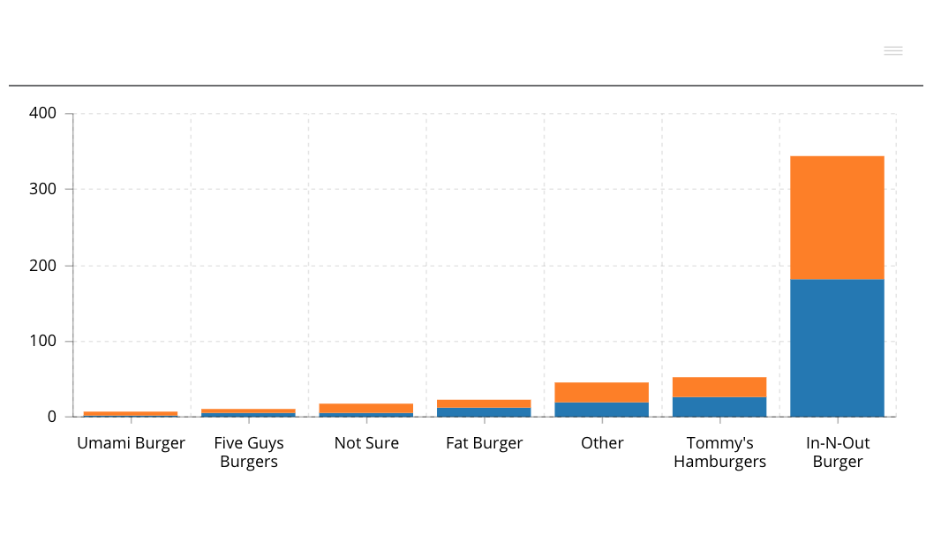
COLORS AND COLUMNS #3

